Slide 1


Impact!: Using Data to Improve Your Fundraising Results
Kathy Wiedemer| Heart Rhythm Society - Director of Development
Simon Jackson| CCS - Executive Director
The Dental Philanthropy Network Washington, DC
November 6, 2015
Notes:
Jeremy

Slide 2
About CCS
Founded 1947
275
Employees
200+
Campaigns per year
Diverse Client Roster:
Associations/Societies and Foundations
Hospitals and Medical Centers
Colleges and Universities
Independent Schools
Arts and Cultural Institutions
Environmental Organizations
Human Services Agencies
125+
Planning studies per year
$5+ billion
in Goals
CCS is one of the most comprehensive and widely recommended fundraising consulting and management firms in the world

Slide 3

About Heart Rhythm Society
Founded 1979
5500
Members
Physicians
Scientists
Allied Professionals
HRS Aims to:
Support excellence in research and education by disseminating findings to the international electrophysiology community and providing the tools to deliver new therapies to patients worldwide.
Advocate for optimal healthcare policies
Help providers deliver quality care by enhancing the patient-provider relationship and information
Members from 72 countries
Public Awareness programs in:
AFIB
Sudden Cardiac Arrest (SCA)
Mission: To improve the care of patients by advancing research, education and optimal health care policies and standards.
3

Slide 4

Presentation Overview
Philanthropic Landscape
Importance of Data in Fundraising
Analysis: Steps and Tools
Heart Rhythm Society – Case Study
Questions and Discussion

Slide 5
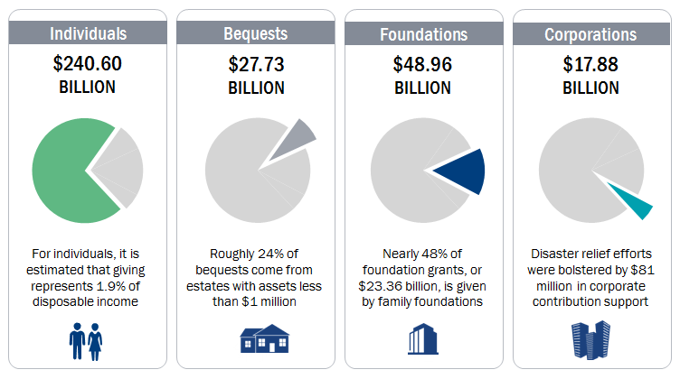
The Philanthropic Landscape
Where the $335.17 Billion Came From In 2013…
Notes:
In 2013, $240.6 billion was given by individuals. We know that medical societies and associations haven’t historically received high levels of individual funding. How do we take advantage of this important source of funding?

Slide 6
Association Foundation Fundraising
Top 10 Methods of Fundraising
2014 AFG Benchmarking Survey
Notes:
Simply put, peer-to-peer fundraising is when you empower your supporters to raise money (from their peers) on your organization’s behalf.
Your job is to provide the right guidance and tools for supporters to create their own personal fundraising campaigns. And more importantly, it’s the strategy that you develop to motivate your fundraisers.

Slide 7
Importance of Data in Fundraising
Data is the basis for analysis
Benchmarking provides a sound basis for comparison
Accurate data is essential for any effective analysis
Take advantage of internal/external benchmarking sources, like AFG!
Analysis allows for informed decision making
Assess progress and performance
Set goals by using metrics
Build accountability
Identify new opportunities
Determine what works best
Bad data = Higher likelihood for failed efforts & frustration

Slide 8
Importance of Data in Fundraising
Maximize Donor Engagement
Build and maintain a base of loyal donors
Understand who your donors are & behaviors
Maximize Donor Development
Win larger donor investment through major & planned gifts
Confirm the known and identify the unknown
Identify new prospects
Make informed asks
Maximize Fundraising Efficiency
Increase ROI
Demonstrate Impact
Gain donors trust
Scale up fundraising operations & results
Raise MORE $
Notes:
TRAVIS:
Effective analysis is what this is all about.
As consultants, CCS wants to provide solid advice using concrete examples in order to drive our clients’ decision making, whether that be a Major Gift Officer directing their energies toward the right prospects or the entire Development Office focusing energies on the right methods for raising money.
Additionally, how we evaluate our fundraising results should also be guided by consistent measurement standards, so we should embrace statistics.
And benchmarking is they way we make sense of all the data we gather. If we just review our own information in a vacuum, then how will we know how good our data really is?

Slide 9
Analysis: Steps and Tools
Analyze Current Situation
Take Action Based on Findings
Collect Data
Compare Your Performance

Slide 10
Analysis: Collect Data
Analyze Current Situation
Take Action Based on Findings
Collect Data
Compare Your Performance

Slide 11
Collect Data: Minimum Required for Healthy Program Analysis
Donor
Constituency
Gift Amount
Date
Appeal
Notes:
Qualitative vs. Quantitative

Slide 12
Collect Data: Aligned by Constituency
Constituencies and Methods
Foundations
Organizations
Direct Mail
Online Solicitation
Major Gifts
Events (tickets, etc.)
Board giving
Planned gifts
CRM
Food and Funds Drives
Event Sponsorship
Cash
In-Kind
Corporate Foundation
Individuals
Cash
Third-Party Events
Corporations
New grants
Renewed grants
Employee Matching
Dues Checkoff
Fees

Slide 13
Collect Data: A Partial List of Metrics
Moves
Face-to-Face Moves
Number of Contacts by Type
Number of proposals
Number of gifts closed
Request Amount
Gift Amount
Prospect Readiness/ Stage
Number of prospects identified
Source of Prospect Identification
Discovery/ qualification activities
Number of prospects qualified
Gift Capacity Rating
Affinity Rating
Date of Prospect Identification
Date of Assignment
Date of Moves through Stages
Date of Gift
Average Time in Each Solicitation Stage
Solicitation Yield (Average Gift/ Average Request)
Conversion Rate (# of Asks/ # of Gifts)
Percent of Portfolio Visited
Portfolio Yield (Amount Raised/ Portfolio Capacity)
Donor Renewal Rate
Notes:
What can be tracked? Think about your tabs in your database. The possibilities are endless.
Giving
Assignment to MGOs
Internal ratings
Dates of Various Moves
Solicitations
All of this is meant to provide context to what our solicitors are doing to identify, cultivate, solicit and steward prospects and donors – and to apply best practices across all solicitors when possible

Slide 14
Collect Data: Challenges Nonprofits Face with Data
Accuracy
Sources
Technology
How good is your data?
What are you using? Are you limiting yourself to internal sources?
Are you capable of doing what you want with the data?
Relevance
To whom can and should we compare our metrics?
ƒ(garbage) = garbage
Notes:
Q: How do participants gather data?

Slide 15
Collect Data: Adopting Metrics
Is what we are measuring designed to produce outcomes?
What will we do with all the information?
Do we have a way to extract the data?
Do we have a way to track data consistently?
Do we have the ability to interpret the data?
How do we stay up-to-date?

Slide 16
Analysis: Analyze Current Situation
Analyze Current Situation
Take Action Based on Findings
Collect Data
Compare Your Performance

Slide 17
Analyze Current Situation: Review current programs and operations
Overall results
Number of Donors
Year-to-Year renewal rate
Fundraising by method
Fundraising by source
Cost to Raise $1
Cost to Raise $1 by method (Events vs. DM vs. Major Gifts)
Progress against goals
Trends over time
Notes:
Overall results – Is the program growing? Achieving goals?
Fundraising by method – What methods are working?
Fundraising by source – Diversified and balanced?
Cost to Raise $1 – Are we efficient? Room for investment?
Cost to Raise $1 by method – What does each method cost?
Progress against goals – Are we achieving success?
Industry/Peer comparison – How do we compare?

Slide 18
Analyze Current Situation: What stands in the way of growth?
Are we efficient?
What methods are/are not working?
Opportunities for improvement
Diversified and balanced?
What is the cost of each method?
Where is there room for investment?
How do we compare to others?
Notes:
Overall results – Is the program growing? Achieving goals?
Fundraising by method – What methods are working?
Fundraising by source – Diversified and balanced?
Cost to Raise $1 – Are we efficient? Room for investment?
Cost to Raise $1 by method – What does each method cost?
Progress against goals – Are we achieving success?
Industry/Peer comparison – How do we compare?

Slide 19
Analysis: Compare Your Performance
Analyze Current Situation
Take Action Based on Findings
Collect Data
Compare Your Performance

Slide 20
Compare Your Performance: Peers
Just Ask!
Call your peers
Look to national trends – AFG, AFP, ASAE, etc.
Share best practices
Ask about their ROI and staffing
We’re all in this together

Slide 21
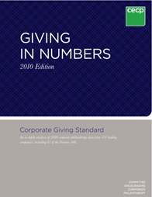

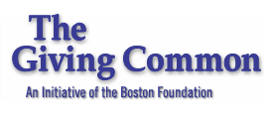

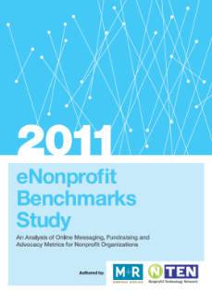









Compare Your Performance: Benchmarks

Slide 22
Analysis: Take Action Based on Findings
Analyze Current Situation
Take Action Based on Findings
Collect Data
Compare Your Performance

Slide 23
Take Action Based on Findings
Set future goals
Make better “investment” decisions
Known strengths and opportunities
Pursue better balance
Invest in more effective methods
Adjust staffing and expenses
Ensure ethical practice
What can/should be added to the program?
Notes:
Data analysis provides justification for changes/new programs

Slide 24

Heart Rhythm Society: Case Study

Slide 25
Heart Rhythm Society: Case Study
HRS Development Data Available in 2013
 | Revenues | Percent Participation
FY 2013 | $195,000 | 1.75%
FY 2012 | $202,000 | 1.75%
FY 2011 | $102,000 | 1%
Challenges
Access to Data
Goals
Get data to work for us
Lack of “Good Data”
Increase donations, support, retention
Notes:
The chart is exactly the information I had. And the information came from a study done by a consultant – not from internal sources.
While the data revealed what was raised and how many participated – actually I had the names of the donors, and calculated the percentages
I did not know:
What methods of fundraising were being used
What was compelling – what was of interest to donors.

Slide 26
Case Study: Interview & Data gathered to prep for 2014
The Heart Rhythm Society is THE resource for information regarding heart rhythm disorders (Annual Meeting, courses, and website.
Large pledges accounted for over half of the revenue, primarily from board members.
An all-member Annual Appeal had never been conducted.
Notes:
This information was broad.
We are an information/education based organization.
So, we needed to find out and track the performance of various fundraising efforts and learn about our constituencies – the personas of our membership, what is important to them and how we can relate to them.
Well, if we weren’t asking for support, we wouldn’t get it --

Slide 27


Case Study: Heart Rhythm Society Celebrates 35th Anniversary!
Notes:
Results:
Kicked off Awareness campaign in a dramatic fashion at Annual Meeting, signage jumbotrons, leadership mentions
Follow-up ads in journal, semi-monthly e-mail communication and letters
AND letters targeted to affinity groups

Slide 28
Case Study: Analyzing the Data
35th Anniversary Appeal FY2014
Affinity Group Segment |  | Champion | 1st Contact | 2nd Contact |  |  | Participation | % Tot $ Raised
Board |  | x | Face-to-Face Meeting | Letter |  |  | 87% | 10%
Major Gift Donors |  | x | Face-to-Face Meeting | Call |  |  | 33% | 62%
Women MDs |  | x | Personal Letter | Email |  |  | 9% | 3%
Allied Professionals |  | x | Personal Letter | Email |  |  | 0.80% | 1%
FHRS |  | x | Personal Letter | Email |  |  | 3% | 4%
Vendors |  | x | Personal Letter | Call |  |  | 78% | 10%
HRS Members |  |  | Email | Email |  |  | 1% | 2%
Pediatric EPs |  | x | Peer-led Group Meeting | Call |  |  | 19% | 8
Notes:
Results:
Conducted an Annual Appeal as well as Select Major Donor face-to-face asks
Collecting and Analyzing the data:
Segmenting with mass appeal did not have robust results
High personalization did --
Another discovery:
HRS has a tremendous affinity for mentor/mentee relationships
The organization needed a human touch, warmth, connection - a lack here and opportunity
So, we took action based on findings and developed a program

Slide 29
Case Study: Fiscal Year Comparisons
 | Revenues | Participation
FY 2014 | $306,000 | 3.5%
FY 2013 | $195,000 | 1.50%
FY 2012 | $202,000 | 1.50%
FY 2011 | $102,000 | 1%
Notes:
Comparative results!
While the results are heading in the right direction, we need a boost
Working with the volunteers, we initiated a new program – one we thought might speak to the deep relationships formed between mentor and mentee in the electrophysiology

Slide 30
Case Study: 2015 Launch Honor Your Mentor
Honor Your Mentor Acknowledge the person who inspired and prepared you to succeed
Website Platform
Engage HRS Mentors and Mentees
Recognition
Notes:
The program has two aspects:
Website Platform:
Slider
Landing Page – Program Explanation
Link to tributes and make a donation
Personalized Engagement – celebrate the Icons
ID Lead Mentee and all mentees – new prospects
1. Write letters on lead mentees letterhead –
2. Follow-up e-mail
Recognition/Promotion
Ad in Journal
Story in monthly e-newsletter
mini-reunion option at AM
mentor/mentee panels at AM

Slide 31
Case Study: HRS Individual Development - Five Year Results
 | Revenues | Participation
FY 2015** | $503,000 | 6%
FY 2014 | $306,000 | 3.5%
FY 2013 | $195,000 | 1.50%
FY 2012 | $202,000 | 1.50%
FY 2011 | $102,000 | 1%
Notes:
27% of the mentees of the six recognized mentors have responded to date, contributing 32% of total amount raised
Success! Social Fundraising at HRS – two mentee originated peer-to-peer appeals
35th Anniversary Campaign – 6% of members contributed – compared to 1.6% (prior average
Engaged 42 volunteers – trained in fundraising
FY program -

Slide 32

Questions/Discussion
What organizational and operational challenges does your nonprofit have in regards to collecting and utilizing data to shape fundraising strategy?
What are the metrics that you find most useful?

Slide 33
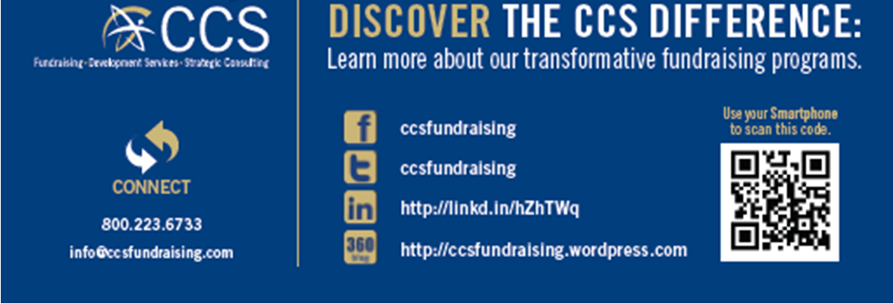
Thank You!
Kathy Wiedemer
Director of Development
Heart Rhythm Society
Kwiedemer@hrsonline.org
www.hrsonline.org
sonline.org
Simon Jackson
Executive Director
CCS
sjackson@ccsfundraising.com
www.ccsfundraising.com

